Slide 1
Java-Multithreading
Instructor :Prashant Mishra
BIAS Bhimtal

Slide 2
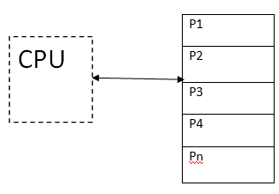
Multiprogramming
"The concurrent residency of more than one program in the main memory is referred as multiprogramming."
Since multiple programs are resident in the memory, as soon as the currently executing program finishes its execution, the next program is dispatched for its consumption.
Also if the currently executing program asks for input output resources then meanwhile another program is dispatched to the CPU for execution.
The main objective of multiprogramming is:
Maximum CPU utilization.
Efficient management of the main memory.
Multiprogramming can be virtually shown as:

Slide 3
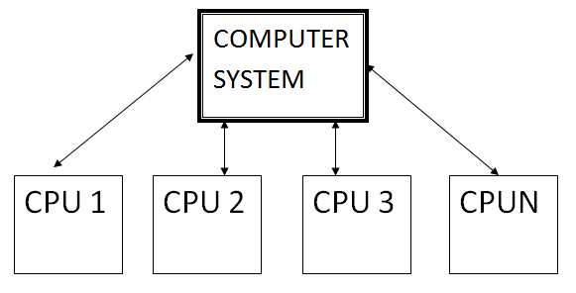
Multiprocessing
When one system is connected to more than one processor which collectively work for the completion of the task, it is called as multiprocessing systems.
Multiprocessing systems can be divided in two types:
Symmetric Multiprocessing: The operating system here resides on one processor and the other processors run user's programs.
Asymmetric Multiprocessing: The OS runs on any available processor or all the processor simultaneously run the user program.
Multiprocessing systems can be virtually represented as:

Slide 4
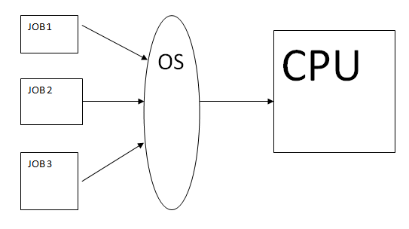
Multitasking
Earlier when computers were invented, a user was allowed to submit only job or task at a time. But later with availability of high-speed processor, one can submit more than one task.
So the capability of OS to accept more the one task per user is termed as multitasking.
Multiple jobs are executed by the CPU simultaneously by switching between them.
The various job can be accepted from same user or different users. There are 2 types of multitasking systems:
Single User Multitasking
Multi User multitasking
It can be virtually represented as:

Slide 5
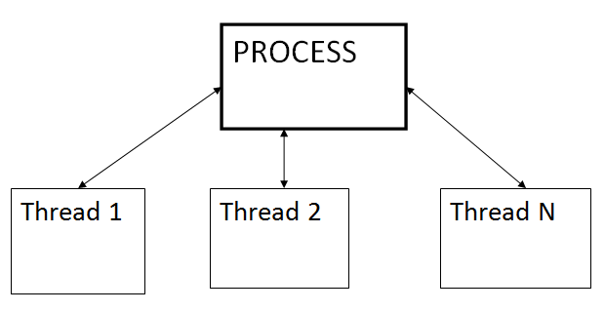
Multithreading
"Multithreading is a conceptual programming paradigm where a process is divided into a number of sub-processes called as threads. Each thread is independent and has its own path of execution with enabled inter thread communication."
"Thread is the path followed while executing a program. Each thread has its own program counter, stack and register."
A thread is a light weight process.
It can be virtually represented as:

Slide 6
No | Characteristic | Multiprogramming | Multiprocessing | Multithreading | Multitasking
1 | What it is: | The concurrent residency of more than one program in the main memory is called as multiprogramming. | The availability of more than one processor per system, which can execute several set of instructions in parallel is called as multiprocessing. | A process is divided into several different sub-processes called as threads, which has its own path of execution. This concept is called as multithreading. | The execution of more than one task simultaneously is called as multitasking.
2 | Number of CPU: | One | More than one | Can be one or more than one | One
3 | Job processing time: | More time is taken to process the jobs. | Less time is taken for job processing. | Moderate amount of time is taken for job processing. | Moderate amount of time.
4 | Number of process being executed: | One process is executed at a time. | More than one process can be executed at a time | Various components of the same process are being executed at a time. | One by one job is being executed at a time.
5 | Economical: | It is economical. | Is less economical. | Is economical. | It is economical.
6 | Number of users: | One at a time. | Can be one or more than one. | Usually one. | More than one.
7 | Throughput: | Throughput is less. | Throughput is maximum. | Moderate. | Throughput is moderate.
8 | Efficiency: | Less | Maximum | Moderate | Moderate
9 | Categories: | No further divisions | Symmetric & Asymmetric. | No further divisions. | Single User & Multiuser.

Slide 7
Multithreading in Java
Multithreading in java is a process of executing multiple threads simultaneously.
A thread is a lightweight sub-process, the smallest unit of processing. Multiprocessing and multithreading, both are used to achieve multitasking.
However, we use multithreading than multiprocessing because threads use a shared memory area. They don't allocate separate memory area so saves memory, and context-switching between the threads takes less time than process.
Java Multithreading is mostly used in games, animation, etc.

Slide 8
A thread is a basic unit of CPU utilization. Multi threading is an execution model that allows a single process to have multiple code segments (i.e., threads) running concurrently within the “context” of that process.
e.g. VLC media player, where one thread is used for opening the VLC media player, one thread for playing a particular song and another thread for adding new songs to the playlist.
Multi threading is the ability of a process to manage its use by more than one user at a time and to manage multiple requests by the same user without having to have multiple copies of the program.

Slide 9
Advantages of Java Multithreading
1) It doesn't block the user because threads are independent and you can perform multiple operations at the same time.
2) You can perform many operations together, so it saves time.
3) Threads are independent, so it doesn't affect other threads if an exception occurs in a single thread.

Slide 10
Multitasking
Multitasking is a process of executing multiple tasks simultaneously. We use multitasking to utilize the CPU. Multitasking can be achieved in two ways:
Process-based Multitasking (Multiprocessing)
Thread-based Multitasking (Multithreading)
1) Process-based Multitasking (Multiprocessing)
2) Thread-based Multitasking (Multithreading)
Each process has an address in memory. In other words, each process allocates a separate memory area.
A process is heavyweight.
Cost of communication between the process is high.
Switching from one process to another requires some time for saving and loading registers, memory maps, updating lists, etc.
Threads share the same address space.
A thread is lightweight.
Cost of communication between the thread is low.

Slide 11
What is Thread in java
A thread is a lightweight sub process, the smallest unit of processing. It is a separate path of execution.
Threads are independent. If there occurs exception in one thread, it doesn't affect other threads. It uses a shared memory area.

Slide 12
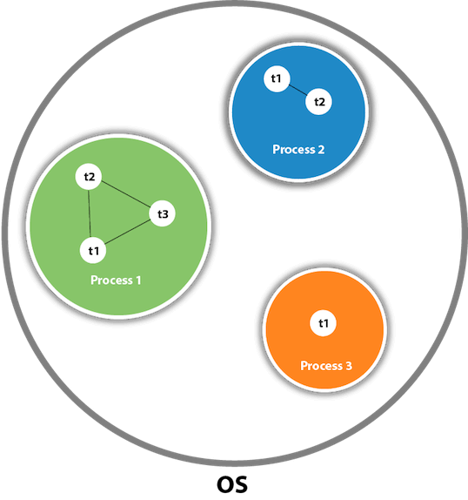
Java Thread class
Java provides Thread class to achieve thread programming. Thread class provides constructors and methods to create and perform operations on a thread. Thread class extends Object class and implements Runnable interface.
As shown in the above figure, a thread is executed inside the process. There is context-switching between the threads. There can be multiple processes inside the OS, and one process can have multiple threads.

Slide 13
Life cycle of a Thread (Thread States)
A thread can be in one of the five states. According to sun, there is only 4 states in thread life cycle in java new, runnable, non-runnable and terminated. There is no running state.
But for better understanding the threads, we are explaining it in the 5 states.
The life cycle of the thread in java is controlled by JVM. The java thread states are as follows:
New
Runnable
Running
Non- Runnable (Blocked)
Terminated

Slide 14
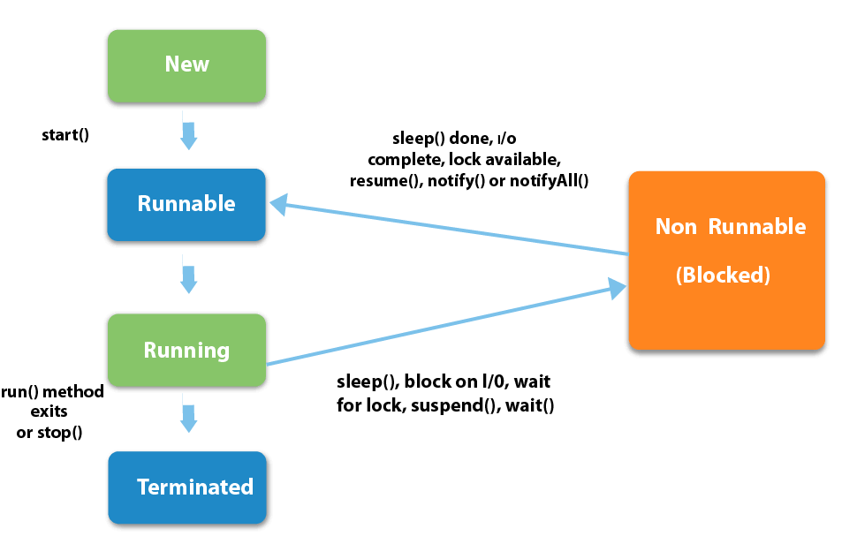

Slide 15
1) New
The thread is in new state if you create an instance of Thread class but before the invocation of start() method.
2) Runnable
The thread is in runnable state after invocation of start() method, but the thread scheduler has not selected it to be the running thread.
3) Running
The thread is in running state if the thread scheduler has selected it.
4) Non-Runnable (Blocked)
This is the state when the thread is still alive, but is currently not eligible to run.
5) Terminated
A thread is in terminated or dead state when its run() method exits.

Slide 16
Priority of a Thread (Thread Priority):
Each thread have a priority. Priorities are represented by a number between 1 and 10. In most cases, thread scheduler schedules the threads according to their priority (known as preemptive scheduling). But it is not guaranteed because it depends on JVM specification that which scheduling it chooses.

Slide 17
How to create thread
There are two ways to create a thread:
By extending Thread class
By implementing Runnable interface.
Thread class:
Thread class provide constructors and methods to create and perform operations on a thread . Thread class extends Object class and implements Runnable interface.

Slide 18
1) Java Thread Example by extending Thread class
class Multi extends Thread{
public void run(){
System.out.println("thread is running...");
}
public static void main(String args[]){
Multi t1=new Multi();
t1.start();
}
}
Output:thread is running...

Slide 19
2) Java Thread Example by implementing Runnable interface
class Multi3 implements Runnable{
public void run(){
System.out.println("thread is running...");
}
public static void main(String args[]){
Multi3 m1=new Multi3();
Thread t1 =new Thread(m1);
t1.start();
}
}
Output:thread is running...

Slide 20
Thread Scheduler in Java
Thread scheduler in java is the part of the JVM that decides which thread should run.
There is no guarantee that which runnable thread will be chosen to run by the thread scheduler.
Only one thread at a time can run in a single process.
The thread scheduler mainly uses preemptive or time slicing scheduling to schedule the threads.

Slide 21
Difference between preemptive scheduling and time slicing
Under preemptive scheduling, the highest priority task executes until it enters the waiting or dead states or a higher priority task comes into existence. Under time slicing, a task executes for a predefined slice of time and then reenters the pool of ready tasks. The scheduler then determines which task should execute next, based on priority and other factors.

